Slide 1
Lecture 17 Topics
Nuclear models
  Liquid Drop model
  Shell model
Radioactive decay
  Alpha decay (α = He nucleus)
  Beta decay: β⁺ decay, β⁻ decay, electron capture
  Gamma decay (γ): photon

Slide 2
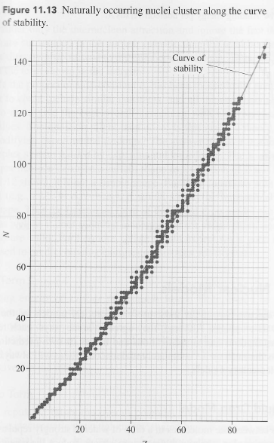
Binding energy/nucleon over Z

Slide 3
Curve of stability
For smaller nuclei,
N=Z to be stable
As nuclei get larger,
N > Z to be stable

Slide 4

Binding energy
m_{P} =1.007276 u
m_{N}=1.008665 u
m_{D}=2.013553 u
uc²=931.5 MeV

Slide 5
Binding energy

Slide 6


Binding energy

Slide 7
Binding energy
Example:
m_{H} =1.007825 u
m_{N}=1.008665 u
uc²=931.5 MeV

Slide 8
Binding energy
Example:

Slide 9
Shell Model
 | Atomic Shell Model | Nuclear Shell Model
Potential | Electrostatic between nucleus and electrons | Net effect of all the forces nucleons experience in a nucleus
Magic numbers | Atoms with closed electronic shells are stable such as He (2 electrons), Ne (10), Ar (18), Kr (36), Xe (54), Rn (86). | Nuclei are particularly stable when the number of nucleons is 2, 8, 20, 28, 50, 82, and 126.
Exclusion principle | Electrons follow the Exclusion principle | Protons and neutrons separately follow the Exclusion Principle
Movement | Electrons move in orbitals | Nucleons do not move like electrons because most nucleons fill states to a maximum level, preventing them from changing momentum.

Slide 10
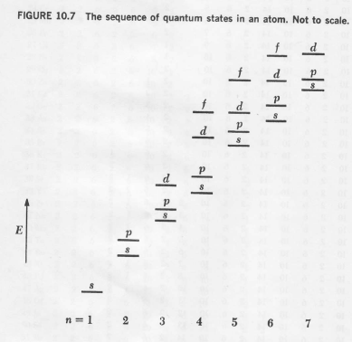
Electrons: Atomic Orbital

Slide 11
Electrons: Atomic Orbital
86: Rn
54: Xe
36: Kr
18: Ar
10: Ne
2: He

Slide 12
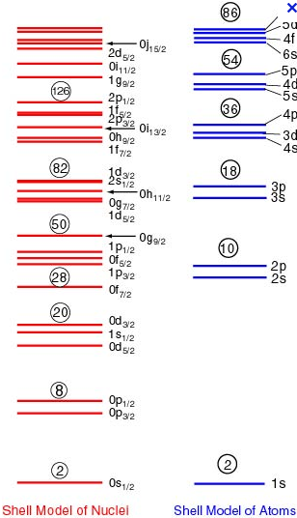
Nuclear Shell Model

Slide 13

3 dimensional harmonic oscillator

Slide 14
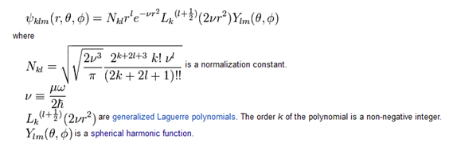
3 dimensional harmonic oscillator

Slide 15

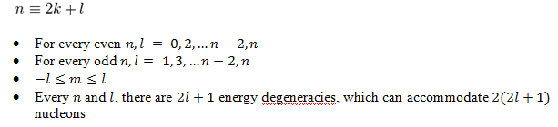
3 dimensional harmonic oscillator

Slide 16


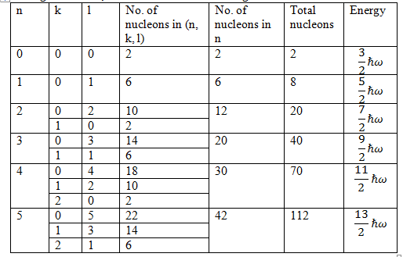
3 dimensional harmonic oscillator

Slide 17
3 dimensional harmonic oscillator

Slide 18
3 dimensional harmonic oscillator

Slide 19
3 dimensional harmonic oscillator

Slide 20
3 dimensional harmonic oscillator

Slide 21
3 dimensional harmonic oscillator
Magic numbers= 2, 8, 20, 28, 50, 82, 126

Slide 22
3 dimensional harmonic oscillator
Not Magic Numbers!!!

Slide 23
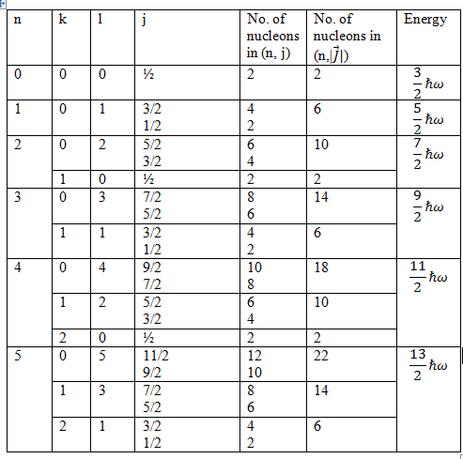
LS coupling

Slide 24
LS coupling

Slide 25
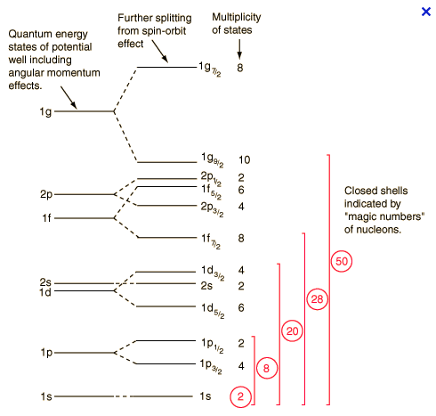
LS coupling

Slide 26
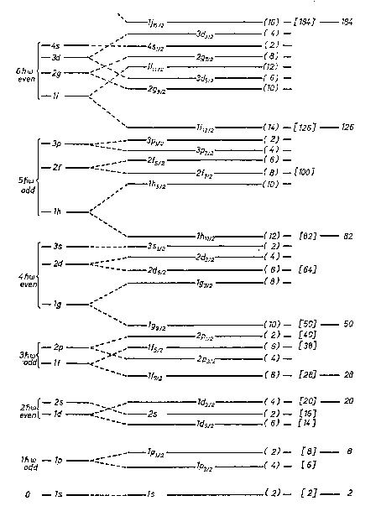

Slide 27
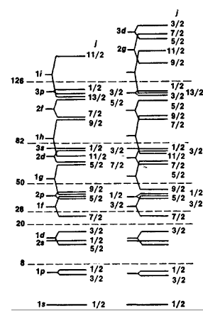
Proton Neutron

Slide 28
Binding energy
m_{P} =1.007276 u
m_{N}=1.008665 u
m_{D}=2.013553 u
uc²=931.5 MeV

Slide 29
Binding energy

Slide 30
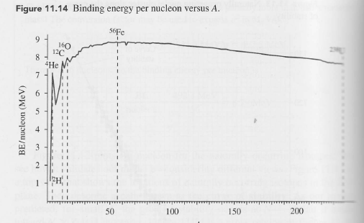
Binding energy/nucleon vs. A
Magic numbers= 2, 8, 20, 28, 50, 82, 126

Slide 31
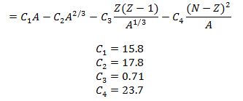
Liquid Drop Model
Binding energy = Volume term + Surface term + Coulomb term + Asymmetric term

Slide 32
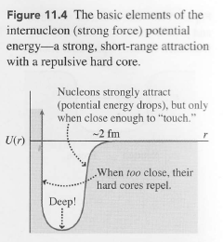
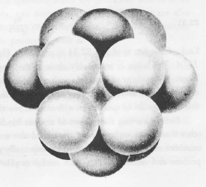
Liquid Drop Model
Binding energy = Volume term + Surface term + Coulomb term + Asymmetric term

Slide 33
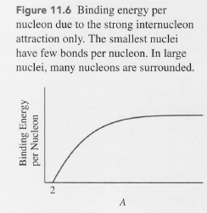
Liquid Drop Model
Binding energy = Volume term + Surface term + Coulomb term + Asymmetric term

Slide 34
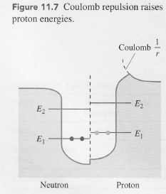
Liquid Drop Model
Binding energy = Volume term + Surface term + Coulomb term + Asymmetric term

Slide 35
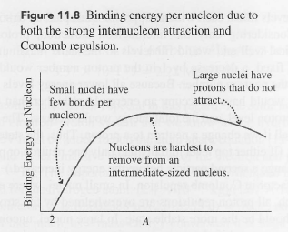
Liquid Drop Model
Binding energy = Volume term + Surface term + Coulomb term + Asymmetric term

Slide 36
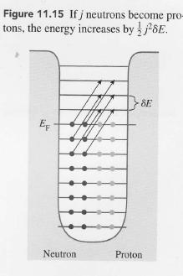
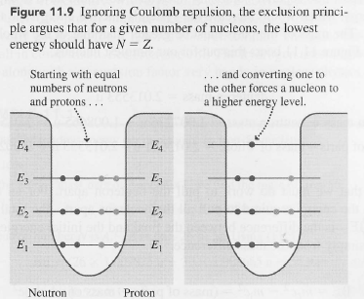
Liquid Drop Model
Binding energy = Volume term + Surface term + Coulomb term + Asymmetric term

Slide 37
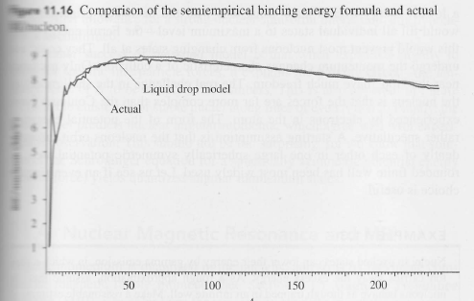
Liquid Drop Model
Binding energy = Volume term + Surface term + Coulomb term + Asymmetric term
Magic numbers= 2, 8, 20, 28, 50, 82, 126

Slide 38
Shell Model
 | Atomic Shell Model | Nuclear Shell Model
Potential | Electrostatic between nucleus and electrons | Net effect of all the forces nucleons experience in a nucleus
Magic numbers | Atoms with closed electronic shells are stable such as He (2 electrons), Ne (10), Ar (18), Kr (36), Xe (54), Rn (86). | Nuclei are particularly stable when the number of nucleons is 2, 8, 20, 28, 50, 82, and 126.
Exclusion principle | Electrons follow the Exclusion principle | Protons and neutrons separately follow the Exclusion Principle
Movement | Electrons move in orbitals | Nucleons do not move like electrons because most nucleons fill states to a maximum level, preventing them from changing momentum.

Slide 39
Electrons: Atomic Orbital
Nucleons: Nuclei Orbital

Slide 40
3 dimensional harmonic oscillator

Slide 41
3 dimensional harmonic oscillator

Slide 42

3 dimensional harmonic oscillator
Not Magic Numbers!!!

Slide 43
3 dimensional harmonic oscillator
2(2l+1)
Not Magic Numbers!!!

Slide 44
3 dimensional harmonic oscillator
2(2l+1)
Not Magic Numbers!!!

Slide 45
LS coupling

Slide 46
LS coupling
2j+1

Slide 47
LS coupling

Slide 48
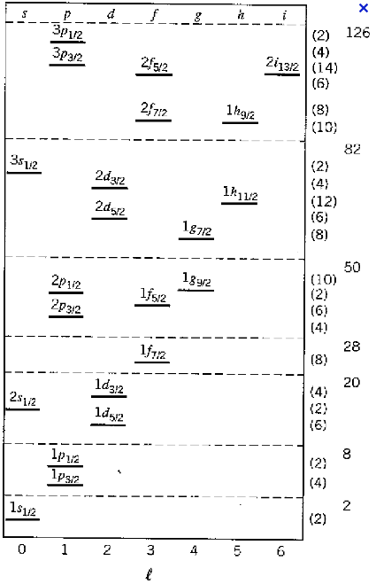
LS coupling

Slide 49
LS coupling
K+1 is the name of energy level

Slide 50
LS coupling
K+1 is the name of energy level

Slide 51
LS coupling
K+1 is the name of energy level

Slide 52
LS coupling
K+1 is the name of energy level

Slide 54
Proton Neutron

