Slide 1
Lecture 16 Topics
Structure of nucleus
Size of nucleus
Strong force and potential
Nuclear binding energy (theoretical/empirical)
  Strong force
  Electrostatic force-repulsive force
  Exclusion principle
Nuclei models
  Liquid Drop model
  Shell model

Slide 2
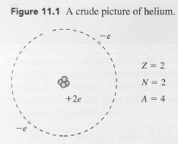

Nucleus

Slide 3
Nucleus
Z= number of protons
N=number of neutrons
A=mass number=number of nucleons=Z+N

Slide 4
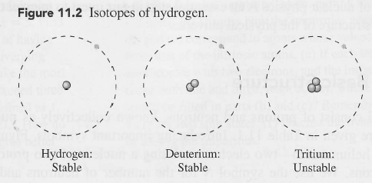
Isotopes
Nuclei | Hydrogen | Deuterium | Tritium
Z
N
A
Electron number

Slide 5
Isotopes
Nuclei | Hydrogen | Deuterium | Tritium
Z | 1 | 1 | 1
N | 0 | 1 | 2
A | 1 | 2 | 3
Electron number | 1 | 1 | 1
Stable

Slide 6
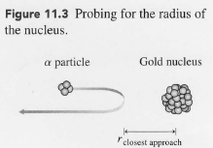
Nucleus size
Rutherford’s alpha particle experiment on Gold foil
The nucleus is roughly spherical
The nucleus is centered at the middle of the atom
The nucleus occupies a relatively small space
The head-on approach would enable the alpha particles to get closest
Nucleus Volume =
Nuclear Density=
Nucleon volume=

Slide 7



Nucleus size
Rutherford’s alpha particle experiment on Gold foil
The nucleus is roughly spherical
The nucleus is centered at the middle of the atom
The nucleus occupies a relatively small space
The head-on approach would enable the alpha particles to get closest
Nuclear Volume =
Nuclear Density=
Nucleon volume=

Slide 8
Nucleus size
Rutherford’s alpha particle experiment on Gold foil
The nucleus is roughly spherical
The nucleus is centered at the middle of the atom
The nucleus occupies a relatively small space
The head-on approach would enable the alpha particles to get closest
Nuclear Volume =
Nuclear Density=
Nucleon volume=

Slide 9
Strong force
→ Strong

Slide 10
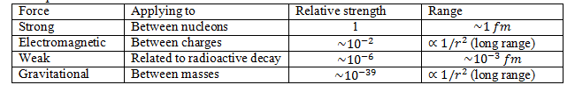
Strong force
→ Strong

Slide 11
Strong force
Strong
attractive
Short-ranged (about 2 fm)
U(r)
r

Slide 12
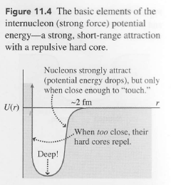
Strong force
Strong
attractive
Short-ranged (about 2 fm)

Slide 13
Strong force
Strong
attractive
Short-ranged (about 2 fm)
Nearly identical between
  Proton-proton
  Neutron-neutron
  Proton-neutron

Slide 14
Nuclear binding: Two nucleons
Protons and neutrons are subject to Exclusion Principle, independently
Parallel spin arrangements in internucleon attraction are more stable

Slide 15
Nuclear binding: Two nucleons
Protons and neutrons are subject to Exclusion Principle, independently
Parallel spin arrangements are more stable
Example:
Use two nucleon arrangements and figure which arrangement is most stable:
Proton-proton
Neutron-neutron
Proton-neutron

Slide 16
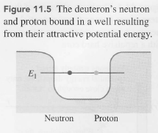
Nuclear binding: Two nucleons
Protons and neutrons are subject to Exclusion Principle, independently
Parallel spin arrangements are more stable
Example:
Proton-neutron pair can be most stably arranged
Experimental evidence:
Deuterium’s nucleus’ (deuteron) total spin is 1
Deuteron has one single bound state.

Slide 17
Multi-nucleon nuclei
Strong force:
  When the total number of nucleons is small:

Slide 18
Multi-nucleon nuclei
Strong force:
  When the total number of nucleons is small:
    The number of bonds each nucleon can have increases, thus binding energy per nucleon increases
  When the total number of nucleons is large

Slide 19
Multi-nucleon nuclei
Strong force:
  When the total number of nucleons is small:
    The number of bonds each nucleon can have increases, thus binding energy per nucleon increases
  When the total number of nucleons is large
surface nucleons
Completely-Surrounded nucleons

Slide 20
Multi-nucleon nuclei
Strong force:
  When the total number of nucleons is small:
    The number of bonds each nucleon can have increases, thus binding energy per nucleon increases
  When the total number of nucleons is large
    Since strong force is short ranged, making each nucleon has the same number of surrounding nucleons.
    The nucleons at the surface are not completely surrounded. The proportion of surface nucleons diminish by 1/r

Slide 21
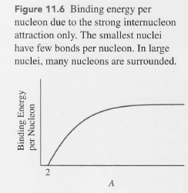
Only strong force is considered

Slide 22
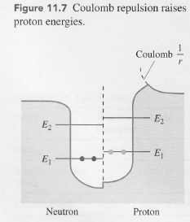
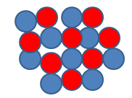
Coulomb repulsion

Slide 23
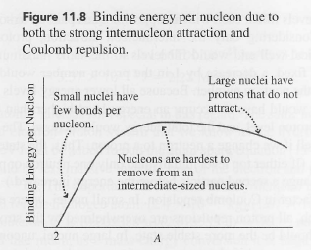
Coulomb repulsion

Slide 24
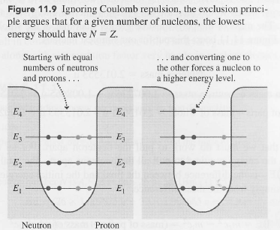
Exclusion principle
For small nuclei, repulsive coulomb interactions are less influential
When N=Z, more stable
When N≠Z, energy raised

Slide 25
Exclusion principle
For small nuclei, repulsive coulomb interactions are less influential
When N=Z, more stable
When N≠Z, energy raised

Slide 26
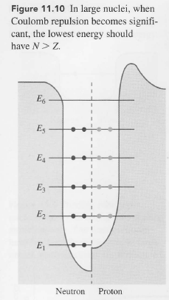
Exclusion principle
For large nuclei, repulsive force changes
N>Z is more stable

Slide 27
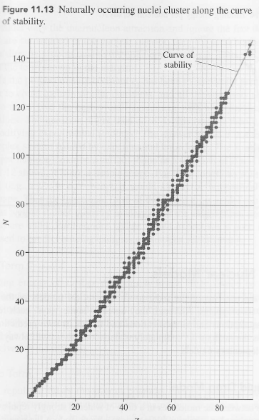
Binding energy/nucleon over Z

Slide 28
Curve of stability
For smaller nuclei,
N=Z to be stable
As nuclei get larger,
N > Z to be stable

Slide 29

Binding energy
m_{P} =1.007276 u
m_{N}=1.008665 u
m_{D}=2.013553 u
uc²=931.5 MeV

Slide 30
Binding energy

Slide 31


Binding energy

Slide 32
Binding energy
Example:
m_{H} =1.007825 u
m_{N}=1.008665 u
uc²=931.5 MeV

Slide 33
Binding energy
Example:

Slide 34
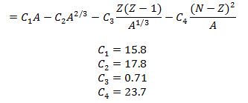
Liquid Drop Model
Binding energy = Volume term + Surface term + Coulomb term + Asymmetric term

Slide 35
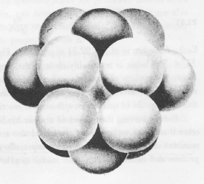
Liquid Drop Model
Binding energy = Volume term + Surface term + Coulomb term + Asymmetric term

Slide 36
Strong force (C1 and C2)
Strong
attractive
Short-ranged (about 2 fm)
Nearly identical between
  Proton-proton
  Neutron-neutron
  Proton-neutron

Slide 37
Liquid Drop Model
Binding energy = Volume term + Surface term + Coulomb term + Asymmetric term

Slide 38
Liquid Drop Model
Binding energy = Volume term + Surface term + Coulomb term + Asymmetric term

Slide 39
Liquid Drop Model
Binding energy = Volume term + Surface term + Coulomb term + Asymmetric term

Slide 40
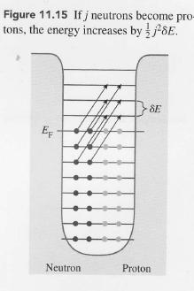
Liquid Drop Model
Binding energy = Volume term + Surface term + Coulomb term + Asymmetric term

Slide 41
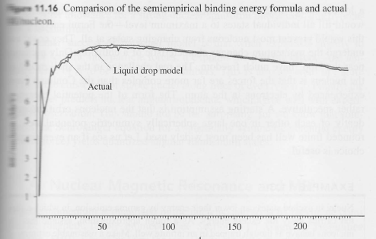
Liquid Drop Model
Binding energy = Volume term + Surface term + Coulomb term + Asymmetric term
Magic numbers= 2, 8, 20, 28, 50, 82, 126

Slide 42
Shell Model
 | Atomic Shell Model | Nuclear Shell Model
Potential | Electrostatic between nucleus and electrons | Net effect of all the forces nucleons experience in a nucleus
Magic numbers | Atoms with closed electronic shells are stable such as He (2 electrons), Ne (10), Ar (18), Kr (36), Xe (54), Rn (86). | Nuclei are particularly stable when the number of nucleons is 2, 8, 20, 28, 50, 82, and 126.
Exclusion principle | Electrons follow the Exclusion principle | Protons and neutrons separately follow the Exclusion Principle
Movement | Electrons move in orbitals | Nucleons do not move like electrons because most nucleons fill states to a maximum level, preventing them from changing momentum.

Slide 43
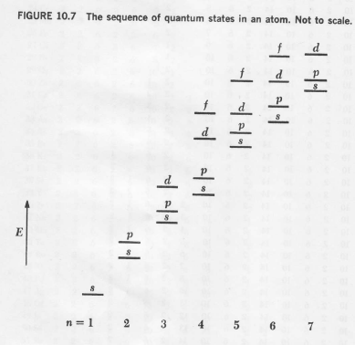
Electrons: Atomic Orbital

Slide 44
Electrons: Atomic Orbital
86: Rn
54: Xe
36: Kr
18: Ar
10: Ne
2: He

Slide 45
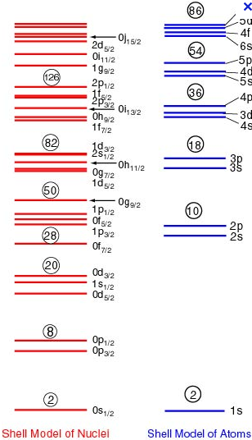
Nuclear Shell Model

Slide 46

3 dimensional harmonic oscillator

Slide 47
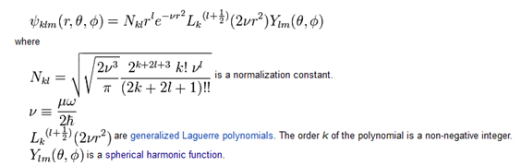
3 dimensional harmonic oscillator

Slide 48

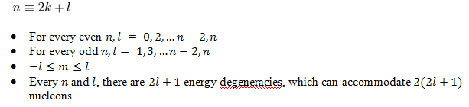
3 dimensional harmonic oscillator

Slide 49


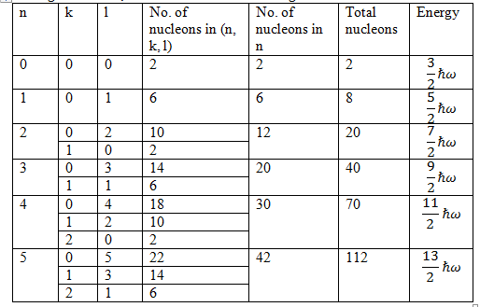
3 dimensional harmonic oscillator

Slide 50
3 dimensional harmonic oscillator

Slide 51
3 dimensional harmonic oscillator

Slide 52
3 dimensional harmonic oscillator

Slide 53
3 dimensional harmonic oscillator

Slide 54
3 dimensional harmonic oscillator
Magic numbers= 2, 8, 20, 28, 50, 82, 126

Slide 55
3 dimensional harmonic oscillator
Not Magic Numbers!!!

Slide 56
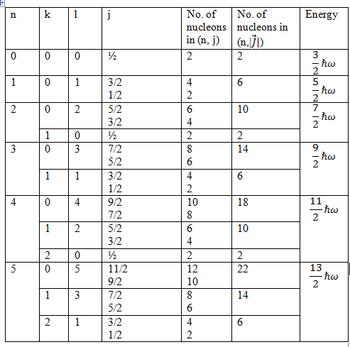
LS coupling

Slide 57
LS coupling

Slide 58
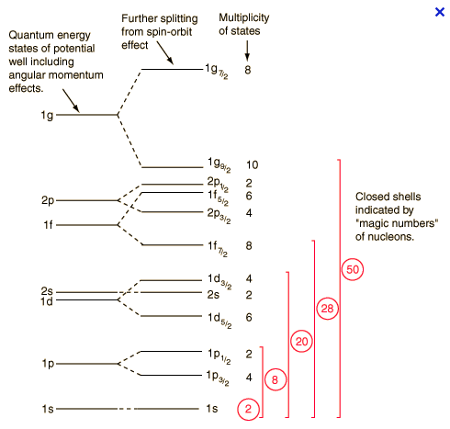
LS coupling

Slide 59
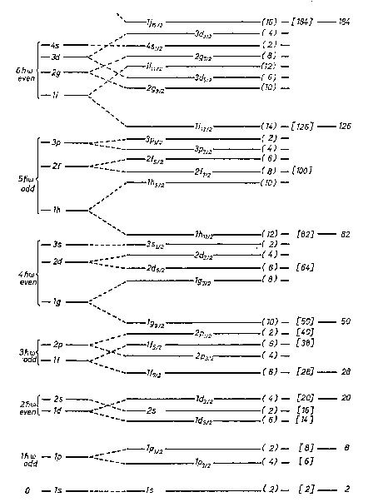

Slide 60
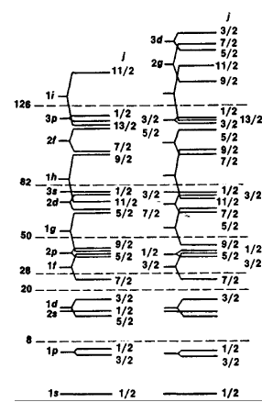
Proton Neutron

