Slide 1
Announcements
02/24, Fri, 5 -6:30 pm, review, ISB 235,
02/27, mon, Galaxy presentation
  Turn in HW4, Lee’s mailbox by 5 pm
  Solutions will be available at 6 pm
02/29, wed, Midterm II
  12:30 pm – 1:50 pm, 80 minutes
  Prof. Belanger will be present

Slide 2
Lecture 17 Topics
Charge carriers
  Conduction electrons
  Valence holes
  Effective mass
Extrinsic semiconductors
  n-type
  p-type
Semiconductor devices
  Diode
  Transistor
Superconductivity
  Characteristics: Perfect conductivity and perfect diamagnetism
  Type 1, Type 2, and High Tc Superconductors
  BCS Theory and Cooper Pairs

Slide 3
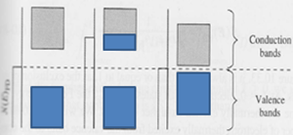
At T = 0

Slide 4
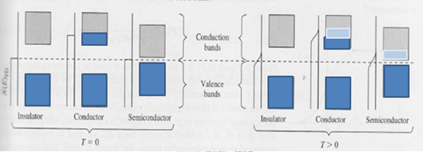
At T = 0
T > 0

Slide 5










T=0
=
T > 0
Insulator: 5 eV
~ 10 ⁻⁴²
Semiconductor: 1 eV
~ 10 ⁻⁸
0.0026 eV

Slide 6
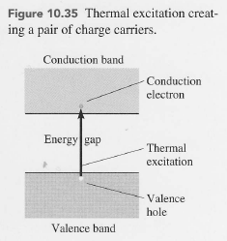
Two types of charge carriers
Conduction band electrons

Slide 7
Two types of charge carriers
Conduction band electrons
Valence band holes

Slide 8
Two types of charge carriers
Conduction band electrons
Valence band holes
- created by electrons left the valence band at T > 0
Behave like positive charge carriers
Are free to move in the valence band
Are always found near the top of the valence band

Slide 9
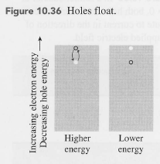
Two types of charge carriers
Conduction band electrons
Valence band holes
- created by electrons left the valence band at T > 0
Behave like positive charge carriers
Are free to move in the valence band
Are always found near the top of the valence band

Slide 10

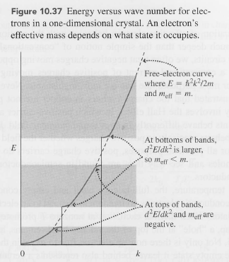

Effective Mass
m_{eff} : the ratio between external force and acceleration
For free electrons,
m_{eff}=

Slide 11
Effective Mass
m_{eff} : the ratio between external force and acceleration
For free electrons,
m_{eff}=
m
At the top of each band

Slide 12

Effective Mass
m_{eff} : the ratio between external force and acceleration
For free electrons,
m_{eff}=
m
At the top of each band

Slide 13


Effective Mass
m_{eff} : the ratio between external force and acceleration
For free electrons,
m_{eff}=
m
At the top of each band
At the bottom of each band

Slide 14
Effective Mass
m_{eff} : the ratio between external force and acceleration
For free electrons,
m_{eff}=
m
At the top of each band
Use Holes to get the positive effective mass!!
At the bottom of each band

Slide 15
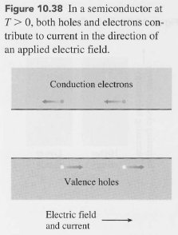
Current in an E field

Slide 16
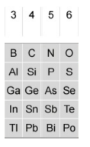
Doping
Intrinsic semiconductors
Extrinsic semiconductors:
  n-type:
    Use elements with 5 valence electrons as impurities
    Extra electron per impurity atom
  p-type:
    Use elements with 3 valence electrons as impurities
    A hole per impurity atom

Slide 17
Doping
p n
Intrinsic semiconductors
Extrinsic semiconductors:
  n-type:
    Use elements with 5 valence electrons as impurities
    Extra electron per impurity atom
  p-type:
    Use elements with 3 valence electrons as impurities
    A hole per impurity atom

Slide 18
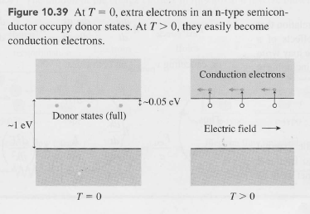
n-type semiconductor
Si: Semiconductor
~
n-type impurity
-create donor states below the conduction band.
-electrons in the donor states can be easily excited to be in the conduction band.
-since impurities are sparse, the donor states do not form energy bands and do not harbor holes.
-in the conduction band, electrons from the donor states are more abundant than those from the valence band
-majority carrier in n-type → conduction band electrons
-minority carrier in n-type → holes in valence band

Slide 19
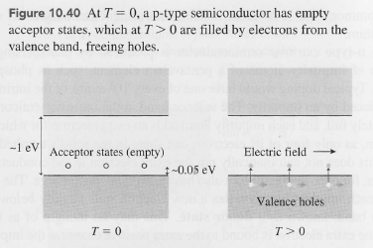
p-type semiconductor
Si: Semiconductor
p-type impurity creates hole
-create acceptor states above the valence band.
-electrons in the valence band can be easily excited to be in the acceptor states, creating holes in the valence band.
-majority carrier in p-type → valence band holes
-minority carrier in p-type → conduction band electrons

Slide 20
Fermi Energy

Slide 21
Fermi Energy
Conductor insulator semiconductor n-type p-type

Slide 22
Fermi Energy
Conductor insulator semiconductor n-type p-type

Slide 23
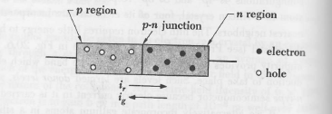


Unbiased Diode (p-n)
p-type
n-type

Slide 24
Unbiased Diode (p-n)
What happens when put together?
p-type
n-type

Slide 25
Unbiased Diode (p-n)
What happens when put together?
p-type
n-type

Slide 26
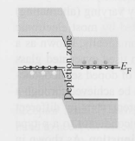
Unbiased Diode (p-n)
-Diffusion of excessive electrons/holes
-Coulomb interactions between new charge distributions resulting from diffusion of electrons and holes
-Depletion zone
+
+
p-type
n-type

Slide 27
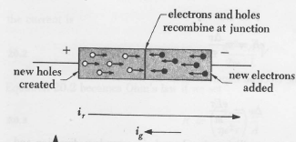
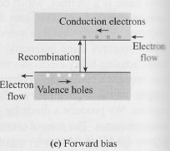
Forward biased
Higher potential at p end
Lower potential at n-end
Electrons are supplied at n-end

Slide 28
Forward biased
Higher potential at p end
Lower potential at n-end
Electrons are supplied at n-end
-electrons and holes recombine when they meet
-current flows continuously
-forward-biasing shifts the n-type conduction band upward, allowing higher energy conduction electrons to fill lower energy valence holes. Energy is lost to heat/light

Slide 29
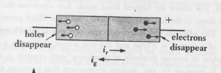
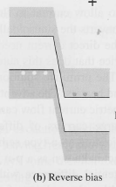
Reverse Biased Diode
Higher potential at n- end
Lower potential at p-end
Electrons disappear at n-end
Holes disappear at p-end

Slide 30
Reverse Biased Diode
Higher potential at n- end
Lower potential at p-end
Electrons disappear at n-end
Holes disappear at p-end
-depletion region (no free charge carriers)
-current stops immediately
-reverse-biasing makes the potential difference more pronounced
-minor charge carriers (conduction electrons in p and valence holes in n) can recombine at a negligible rate

Slide 31
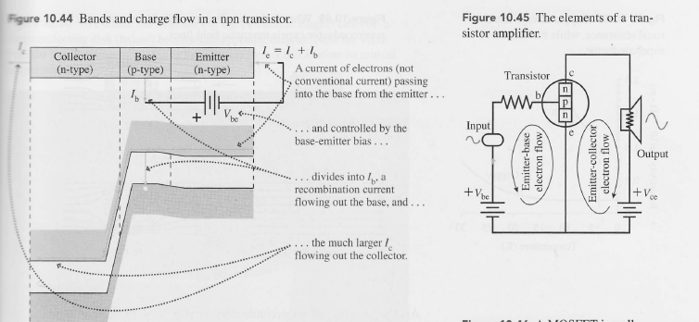
Transistor (npn)

Slide 32
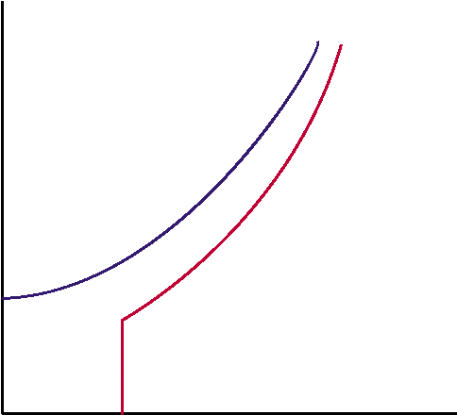
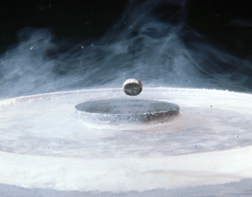
Superconductivity:
Essential Characteristics
1911 K. Onnes Superconductivity in Hg
1933 Meissner effect
RESISTANCELESS CONDUCTION
MEISSNER EFFECT:
Perfect diamagnetism
Metal
Resistivity
Superconductors
T_{c}
0
Temperature

Slide 33
Understanding of Superconductivity
1950 Isotope effect T_{c}~M^{−α} (α∼1/2)
1957 BCS Theory
(Bardeen, Cooper, Schrieffer)
1962 Tunneling experiments
Transition Temperature (K)
BCS Theory
Year of Discovery

Slide 34
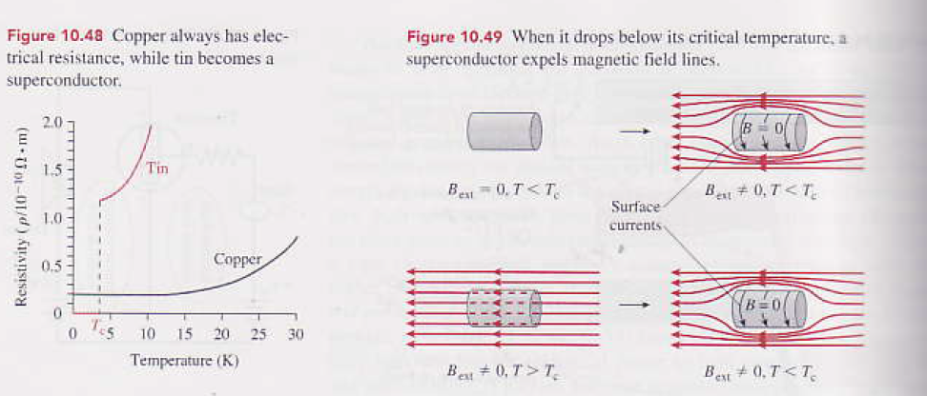
Superconductivity
Perfect conductivity—critical temperature (Tc)
Perfect diamagnetism- critical B field (Bc)

Slide 35
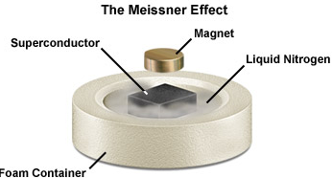
Superconductivity
Perfect conductivity—critical temperature (Tc)
Perfect diamagnetism- critical B field (Bc)
Superconductors repel magnets

Slide 36
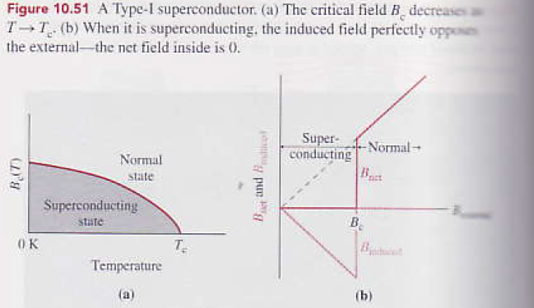
Type 1 Superconductors
-Sharp transition at Bc
-No B field in the superconducting material because Bext is cancled by B-induced before Bc
-After Bc, the superconducting material is in a normal state allowing Bext to penetrate the material
-Superconducting elements tend to be Type 1
-Bc is relatively low, 0.01-0.1 T
-Tc is relatively low, 1-9 K

Slide 37
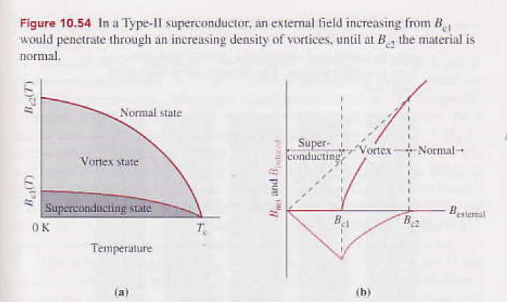
Type 1 vs. 2 Superconductors

Slide 38
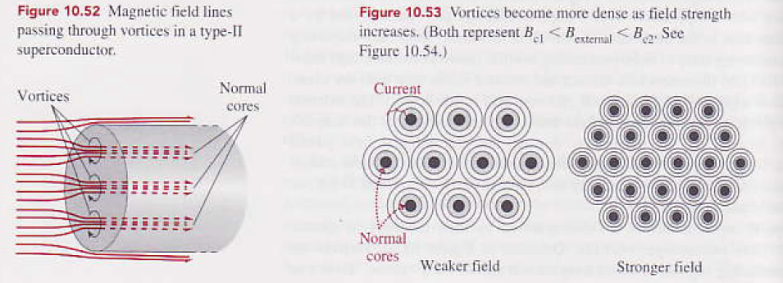
Type 2 Superconductors
-Vortices: superconducting regions surrounding normal cores
-Stronger field makes vortices become more dense, allowing more field lines to penetrate.
-metallic compounds and alloys
-Bc are 2-3 orders of magnitude grater than type 1
-Tc is twice as high as type 1, around 20K

Slide 39
BCS Theory
Bardeen, Cooper, and Schrieffer (BCS)
Explains Type 1 and Type 2 superconductors
Lattice and electron interactions
Coherent motion of the electrons in Cooper pairs
  What is cooper pair?
  How coherent motion is created?

Slide 40
BCS theory
PHONON MEDIATED PAIRING
(phonon = lattice vibration)
Pairs of electrons: Cooper pairs
+Z
+Z
Superconducting gap: Δ
e
M
+Z
+Z
T_{c}~M^{-1/2}
e

Slide 41
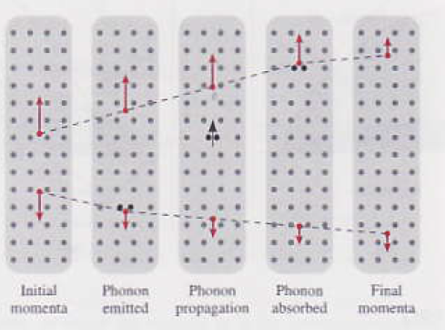
Cooper Pairs
Cooper paired electrons
-are bosons as a pair
-have opposite momenta
-opposite spin directions

Slide 42
Cooper Pairs
Cooper paired electrons
-are bosons as a pair
-have opposite momenta
-opposite spin directions
-Paired electrons experience a net attraction by exchanging a phonon
-Lattice is involved
-This attractive force is small at the order of 0.001 eV which is greater than electron –electron repulsion
-the separation between the two paired electrons is greater than atomic spacing in the lattice
T_{c}~M^{-1/2}

Slide 43
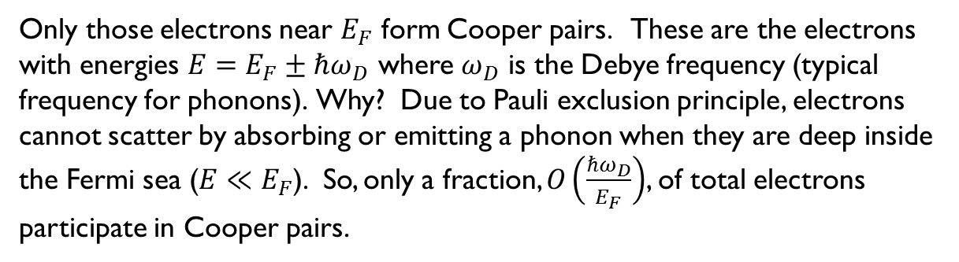
How many electrons participate?
Only those electrons near $E_{F}$ form Cooper pairs. These are the electrons
with energies $E=E_{F}±ℏω_{D}$ where $ω_{D}$ is the Debye frequency (typical frequency for phonons). Why? Due to Pauli exclusion principle, electrons cannot scatter by absorbing or emitting a phonon when they are deep inside the Fermi sea ($E≪E_{F}$). So, only a fraction, $O\left(\frac{ℏω_{D}}{E_{F}}\right)$, of total electrons participate in Cooper pairs.

Slide 44
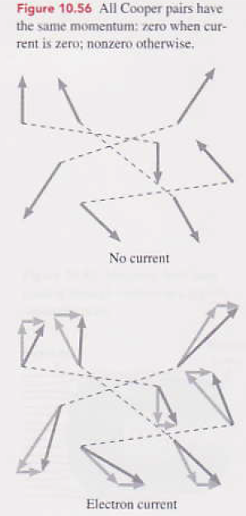
Coherent motion of Cooper pairs
Cooper paired electrons
-are bosons as a pair
-have opposite momenta
-opposite spin directions
-binding energy between electrons in a Cooper pair is greater than typical thermal energy between electron and lattice ion at low temperatures
-thus, collisions are not going to stop electrons in cooper-pairs to move coherently
-Type 1 superconductors have longer mean free paths than Type 2 superconductors

Slide 45

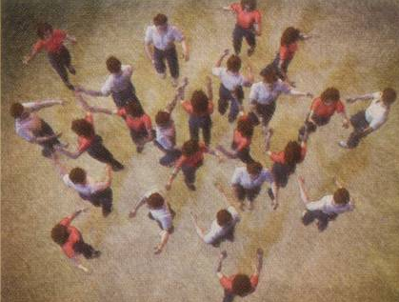
Superconductivity – Dance of Electron Pairs
Origin of SC = PAIRS dancing to the SAME tune
Phys. Today, March ‘04
Notes:
So, I described to you what is the phenomenology of the superconductivity.
But, what is the microscopic origin?
Regardless of conventional or high temperature superconductivity, researchers agree on one aspect.
Namely, the superconductivity is due to pairing of two electrons.
In this illustration, a female person symbolizes an electron with one spin quantum number and a male person symbolizes another electron with the other spin quantum number.
Then, the superconducting state is a state in which each female and each male are happily paired together and dancing together in a sort of harmonious and happy fashion.
Of course, in this illustration, it is not noted just what is pairing these two electrons.

