Slide 1
Lecture 18
Superconductivity

Slide 2
Superconductivity
Perfect diamagnetism
Perfect conductivity

Slide 3
What we will learn
Diamagnetic character
Microscopic origin (Cooper pair, BCS)
Macroscopically coherent quantum state (BEC)
Current density and wave function
Different types of superconductors
Flux quantization

Slide 4
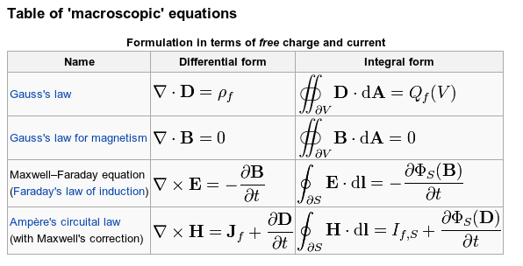
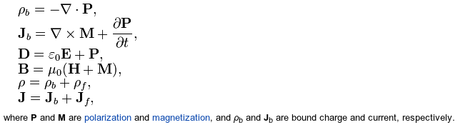
Diamagnetism??
Anti-parallel!

Slide 5
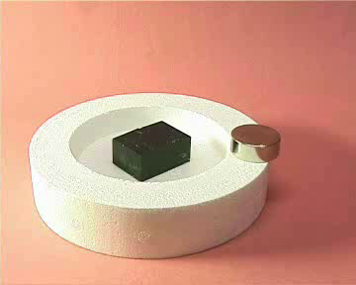
Meissner Effect (perfect diamagnet)
http://www.fys.uio.no/super/levitation/

Slide 6
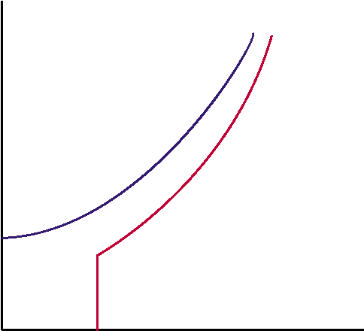
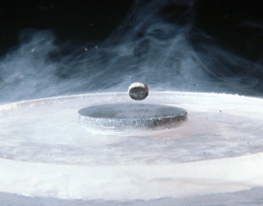
Essential Characteristics
1911 K. Onnes Superconductivity in Hg
1933 Meissner effect
RESISTANCELESS CONDUCTION
MEISSNER EFFECT:
Perfect diamagnetism
Metal
Resistivity
Superconductors
T_{c}
0
Temperature

Slide 7
Understanding of Superconductivity
1950 Isotope effect T_{c}~M^{−α} (α∼1/2)
1957 BCS Theory
(Bardeen, Cooper, Schrieffer)
1962 Tunneling experiments
Transition Temperature (K)
BCS Theory
Year of Discovery

Slide 8
BCS theory
PHONON MEDIATED PAIRING
(phonon = lattice vibration)
Pairs of electrons: Cooper pairs
+Z
+Z
Superconducting gap: Δ
e
El-ph coupling constant: λ
M
+Z
+Z
T_{c}~ω_{ph} exp(-1/λ)~M^{-1/2}
e
e-ph wins e-e at low freq. (Slow Wins!)

Slide 9
How many electrons participate?
Not all electrons can participate in Cooper pairing.
In quantum mechanical view, the interaction described in the previous slide is described as two electrons exchanging a phonon (lattice vibration quantum).

Slide 10
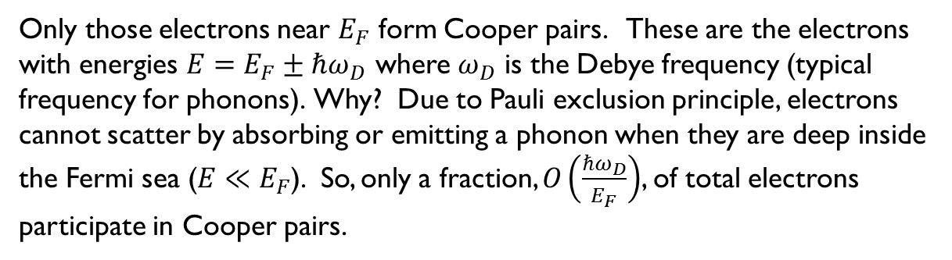
How many electrons participate?
Only those electrons near $E_{F}$ form Cooper pairs. These are the electrons
with energies $E=E_{F}±ℏω_{D}$ where $ω_{D}$ is the Debye frequency (typical frequency for phonons). Why? Due to Pauli exclusion principle, electrons cannot scatter by absorbing or emitting a phonon when they are deep inside the Fermi sea ($E≪E_{F}$). So, only a fraction, $O\left(\frac{ℏω_{D}}{E_{F}}\right)$, of total electrons participate in Cooper pairs.

Slide 11

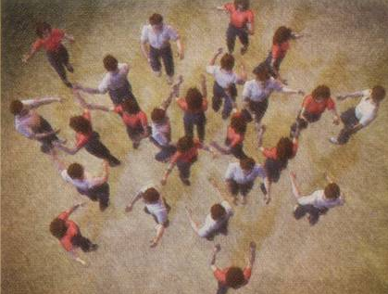
Superconductivity – Dance of Electron Pairs
Origin of SC = PAIRS dancing to the SAME tune
Phys. Today, March ‘04
Notes:
So, I described to you what is the phenomenology of the superconductivity.
But, what is the microscopic origin?
Regardless of conventional or high temperature superconductivity, researchers agree on one aspect.
Namely, the superconductivity is due to pairing of two electrons.
In this illustration, a female person symbolizes an electron with one spin quantum number and a male person symbolizes another electron with the other spin quantum number.
Then, the superconducting state is a state in which each female and each male are happily paired together and dancing together in a sort of harmonious and happy fashion.
Of course, in this illustration, it is not noted just what is pairing these two electrons.

Slide 12
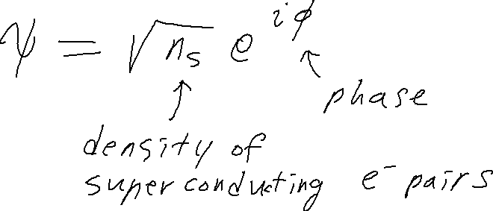
Superconducting Order Parameter
(Ginzburg-Landau; Gorkov)
Can be viewed as the “wave function” of the condensate (i.e. ALL electron pairs)
All electron pairs (Cooper pairs) have the same wave function, in particular the same phase (like photons in laser)

Slide 13
What does it really mean that all pairs have the same wave function?
Identical particles
  All electrons (fermions) are indistinguishable in quantum mechanics.
  All electron pairs – Cooper pairs – (bosons) are indistinguishable in quantum mechanics.
When identical bosons “condense”, we got a Bose-Einstein condensation. → Superfluid (no charge), Superconductor (charge)
A quantum state with macroscopic coherence

Slide 14
What does it really mean that all pairs have the same wave function?
All bosons in the same wave functions.
A crude analogy is the vibrations in a guitar string or an ocean wave or any similar wave phenomenon. (Although such systems are not quite clean enough. Laser is a much better analogy.)
A large amplitude in a wave means many quanta of vibrations – many bosons!
Can we distinguish one vibration quantum from another when a guitar string vibrates? No. Such a state must be viewed as collective.
Except that in superconductors, these indistinguishable bosons are “tangible stuff” electron pairs – so, it is mind-boggling…
A quantum state with macroscopic coherence (all = one)

Slide 15





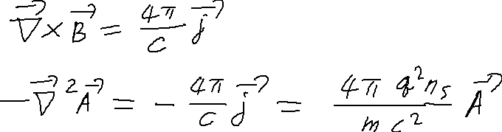


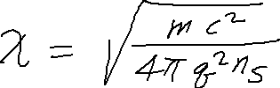
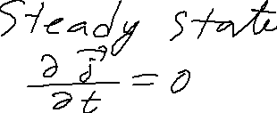



So How does it work?
Hamiltonian in presence of A
London Equation
Cooper Pair
cgs unit
Meissner Effect
Infinite Conductivity

Slide 16




Two Length Scales and two types of SC

Slide 17
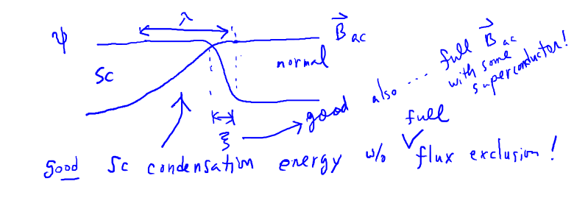
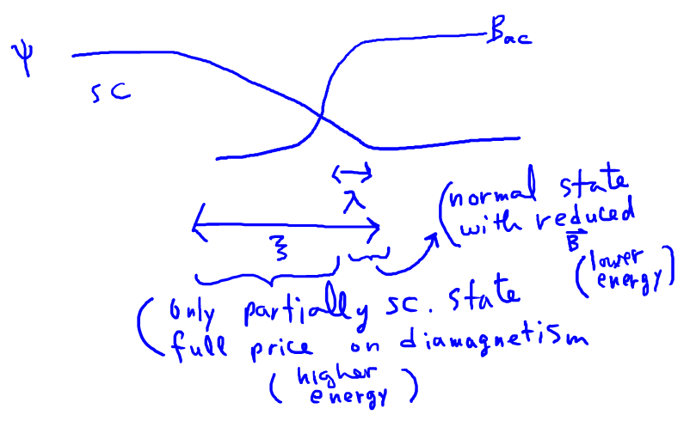
Two Length Scales and two types of SC
Type II
Type I

Slide 18
Two types of SC

Slide 19
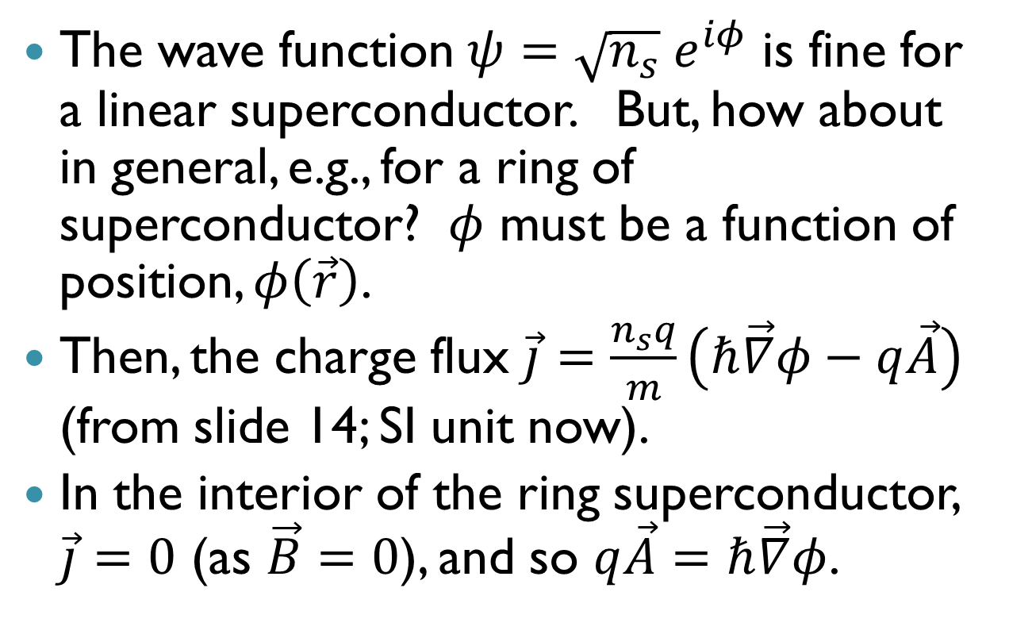
Flux quantization
The wave function $ψ=\sqrt{n_{s}} e^{iφ}$ is fine for a linear superconductor. But, how about in general, e.g., for a ring of superconductor? $φ$ must be a function of position, $φ\left(\vec{r}\right)$.
Then, the charge flux $\vec{j}=\frac{n_{s}q}{m}\left(ℏ\vec{∇}φ−q\vec{A}\right)$ (from slide 14; SI unit now).
In the interior of the ring superconductor, $\vec{j}=0$ (as $\vec{B}=0$), and so $q\vec{A}=ℏ\vec{∇}φ$.

Slide 20
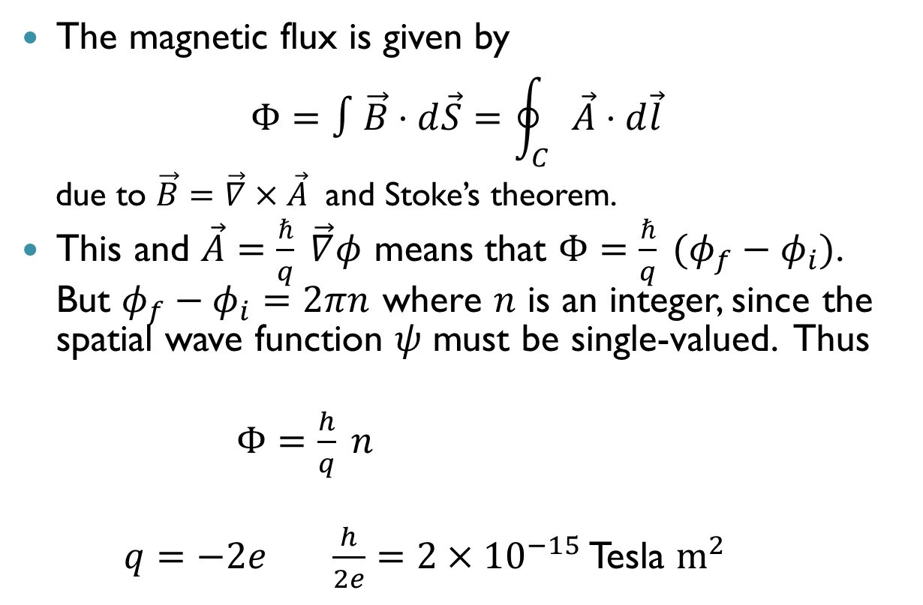
Flux quantization
The magnetic flux is given by
$$Φ=∫\vec{B}⋅d\vec{S}=\oint_{C}{\vec{A}⋅d\vec{l}}$$
  due to $\vec{B}=\vec{∇}×\vec{A}$ and Stoke’s theorem.
This and $\vec{A}=\frac{ℏ}{q} \vec{∇}φ$ means that $Φ=\frac{ℏ}{q} (φ_{f}−φ_{i})$. But $φ_{f}−φ_{i}=2πn$ where $n$ is an integer, since the spatial wave function $ψ$ must be single-valued. Thus
$Φ=\frac{h}{q} n$
$q=−2e$ $\frac{h}{2e}=2×{10}^{−15}$ Tesla $m^{2}$

