Slide 1
PH102: Interactive Lecture 5
Topics
  3d Schrodinger Equation for Hydrogen atom
  Separation of variables
  Three equations
  Three quantum numbers
  Wave functions
  Quantization of angular momentum (L)

Slide 2
Hydrogen atom
Potential created by Coulomb interactions between electron (-e) and proton (+e)

Slide 3

Hydrogen atom
Potential created by Coulomb interactions between electron (-e) and proton (+e)

Slide 4
Hydrogen atom
Potential created by Coulomb interactions between electron (-e) and proton (+e)
  Symmetric in r
  Choose

Slide 5

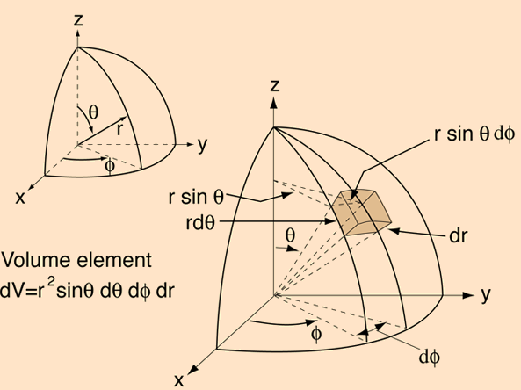


Slide 6
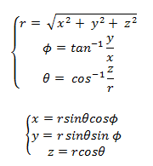


Slide 7


Schrodinger Equation

Slide 8
Schrodinger Equation

Slide 9

Schrodinger Equation

Slide 10

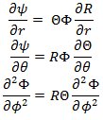
Schrodinger Equation

Slide 11

Schrodinger Equation

Slide 12
Schrodinger Equation
Angular part
Radial part

Slide 13
Schrodinger Equation
Angular part
Radial part
-l (l + 1)

Slide 14

Schrodinger Equation
Angular part
Radial part
-l (l + 1)

Slide 15
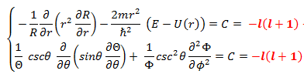
Schrodinger Equation
Angular part
Radial part
-l (l + 1)

Slide 16


Schrodinger Equation
Angular part
Radial part
-l (l + 1)

Slide 17
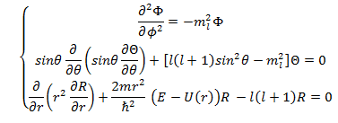
Schrodinger Equation

Slide 18
Schrodinger Equation
Azimuthal Equation
Polar Equation
Radial Equation

Slide 19

Azimuthal Equation
Wave function
Boundary condition
Quantization

Slide 20

Azimuthal Equation
Wave function
Boundary condition
Quantization

Slide 21
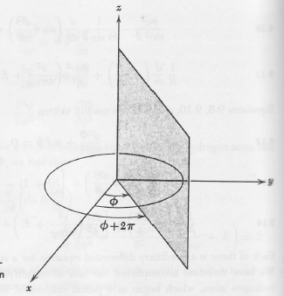
Azimuthal Equation
Wave function
Boundary condition
Quantization

Slide 22

Azimuthal Equation
Wave function
Boundary condition
Quantization

Slide 23
Azimuthal Equation
Wave function
Boundary condition
Quantization

Slide 24
Azimuthal Equation
Wave function
Boundary condition
Quantization
Magnetic quantum number

Slide 25


Polar Equation
Solutions: Associated Legendre Functions
Quantization
→ Orbital quantum number

Slide 26


Radial Equation
Solutions: associated Laguerre functions
Quantization:
n → Principal quantum number
l = 0, 1, 2, …(n-1)

Slide 27


Solutions

Slide 28
Symbolic designation of atomic states
 | s l = 0 | p l =1 | d l =2 | f l =3 | g l = 4 | h l =5
n = 1 | 1s
n = 2 | 2s | 2p
n = 3 | 3s | 3p | 3d
n = 4 | 4s | 4p | 4d | 4f
n = 5 | 5s | 5p | 5d | 5f | 5g
n = 6 | 6s | 6p | 6d | 6f | 6g | 6h

Slide 29


Origin of angular momentum quantization

Slide 30

Origin of angular momentum quantization

Slide 31

Origin of angular momentum quantization

Slide 32
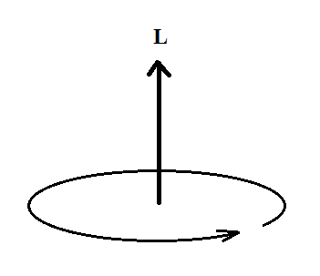

Origin of angular momentum quantization

Slide 33

Origin of angular momentum quantization

Slide 34
Origin of angular momentum quantization
Angular momentum is quantized

Slide 35
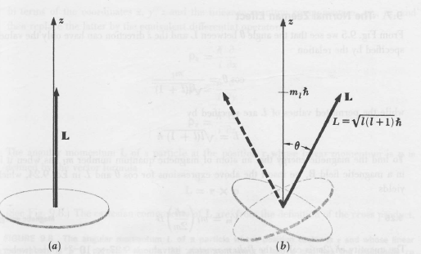
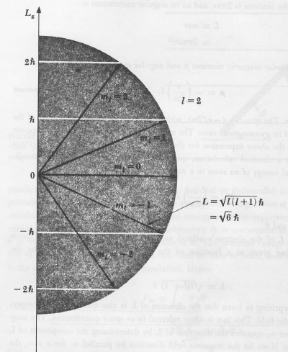
Angular Momentum (L)
Amount =
Direction =

Slide 36

Angular Momentum (L)
Amount =
Direction = determines the direction of L

